Slide 1
Staying Safe Online

Slide 2
Going Online
Talk About It
When do you go online? Why do you go online?
We go online for lots of reasons including:
watching TV shows
playing games
watching online videos
talking to friends
finding out things
homework
The Internet can be loads of fun!

Slide 3
But…
Who do you think owns the Internet?
Who do you think decides what can be put on to it?
Who makes sure the things on the Internet are truthful and real?
No one owns the Internet. No one decides what can be put on.
The Internet can be used by everyone and everyone can add things to it!
Talk About It
Trust means to be able to count on someone and know they are telling the truth. Do you think you can trust everything and everyone on the internet?

Slide 4
Would you…?
Talk to your partner about these two different situations. Tell them whether you would or wouldn’t do each thing and explain why.
If a stranger came up to you in the street, talked to you and asked you to go with them because they had something really good to show you, would you go?
If a stranger came up to you and told you they were giving away free televisions in a house up the road, would you believe them?

Slide 5
Would you…?
Here are some important things to remember when you are online:
Just like in the real world, the Internet has both nice and nasty people using it.
There might be people who want to help you and people who may want to trick you or be nasty to you. But you can’t see the people using the Internet and it is hard to tell who is nice and who isn’t!

Slide 6
Stay safe online
Remember anyone can use and add things to the Internet, which means that we can’t always trust what we see on it.
We can’t always trust that people who want to talk to us on the Internet are nice.
We can’t always trust the websites on the Internet. Some may have viruses that can stop our computers from working properly!
So how can we use the Internet for all the fun things but still stay safe?

Slide 7
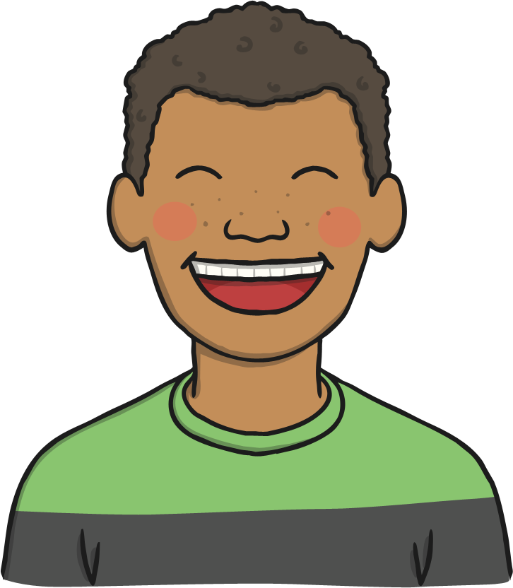
How to stay safe:
Try to only use websites you know can be trusted. If you aren’t sure – ask an adult!
Try to use websites that are for children as much as possible.
Remember - some people will pretend to be children to talk to you. Never give out your name or address! We don’t really know who we are talking to when we chat through the Internet.
Never arrange to meet an online friend without telling an adult!
Remember if you aren’t sure about anything, always ask a grown up.

Slide 8
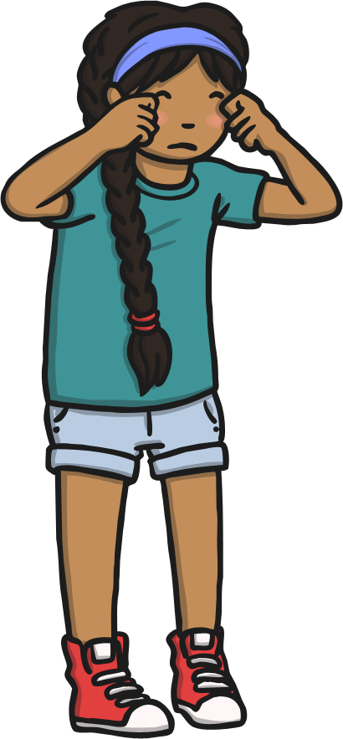
Bullying
Talk About It
What is bullying?
Bullying is when a person tries on purpose to hurt another one, either in what they say or what they do. It usually happens more than once.
Some people use the Internet to bully others. This is called cyberbullying.

Slide 9
Cyberbullying
The cyberbullies may:
send nasty text messages or emails;
say unkind things about people on social
networking sites;
try to get others to say unkind and nasty things too;
send unkind photographs to lots of people.
Cyberbullying hurts people just the same as any other bullying.

Slide 10
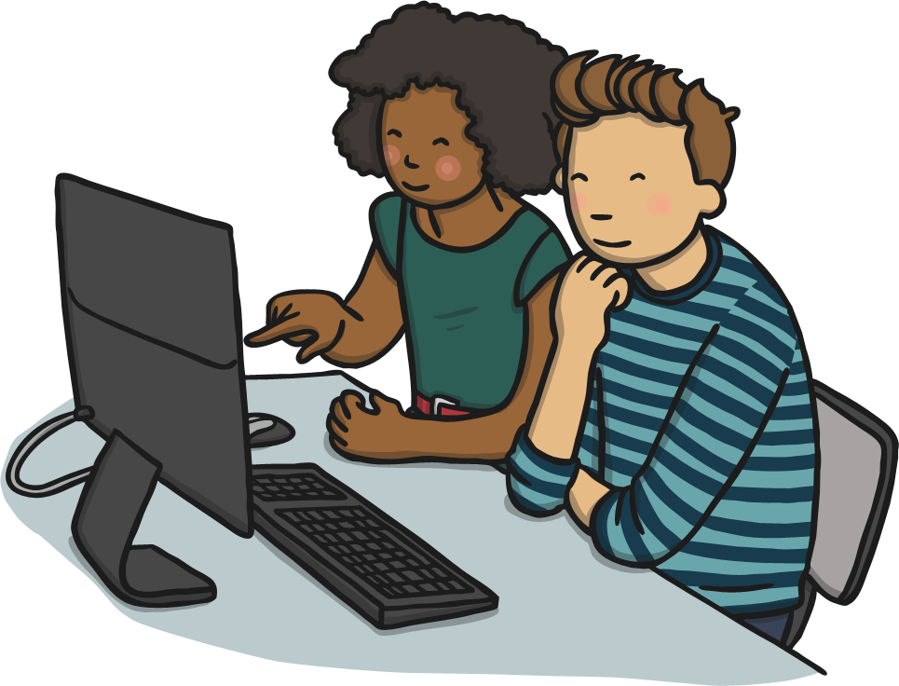
What If You’re Upset?
The most important thing to remember is if you see something that upsets you, tell an adult. It might be a grown up you live with or a teacher at school.
They can help you to report the thing you saw.
They can talk to you and make you feel OK and they can help you to find a website that is better.
They can help to stop the bullies hurting other people too.
No one has the right to hurt or upset anyone else – even online!

Slide 11
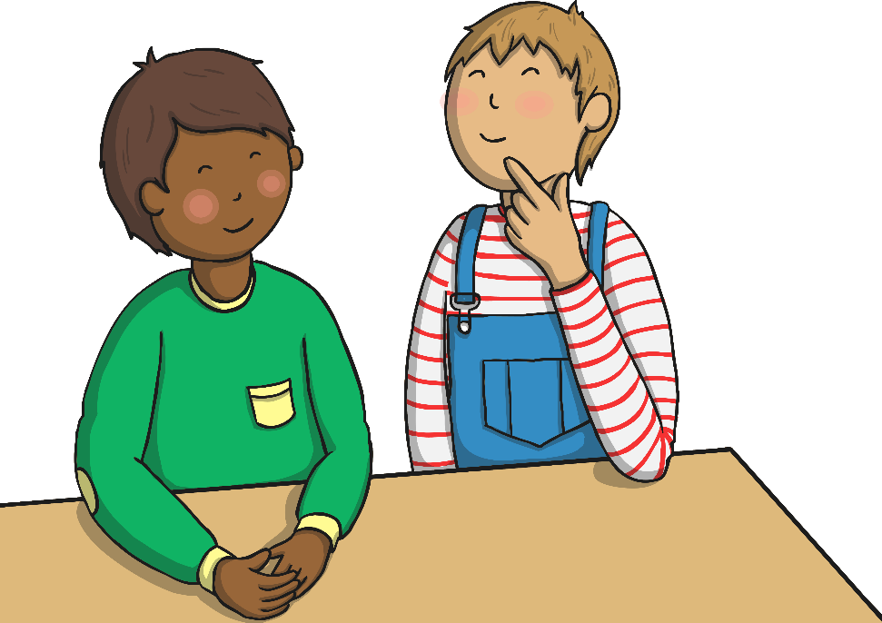
What Should You Do?
If you see someone else being bullied online, don’t join in or be nasty to the bullies. Tell an adult.
Don’t write unkind things about other people, or use nasty words. You can’t see the person – but it will still hurt them!

Slide 12
Remember to Be SMART
Stay Safe: Never give your name, address or passwords out to anyone online. They may say they are the same age as you but they could be lying!
Meet: Never go to meet someone you have made friends with online. If an online friend wants to see you, talk to an adult. Remember that they might not be who they say they are!
Accepting: If someone sends you a photo, or a file, ask an adult before you open it. It could have a virus! Don’t accept it!
Reliable: Remember that you can’t trust everyone who uses the Internet. Not everyone is kind. They aren’t reliable.
Tell: Tell an adult if something online upsets you or makes you worried.

